Slide 1
Tutorial 9 Simulation of the Asset Exchange Model

Slide 2
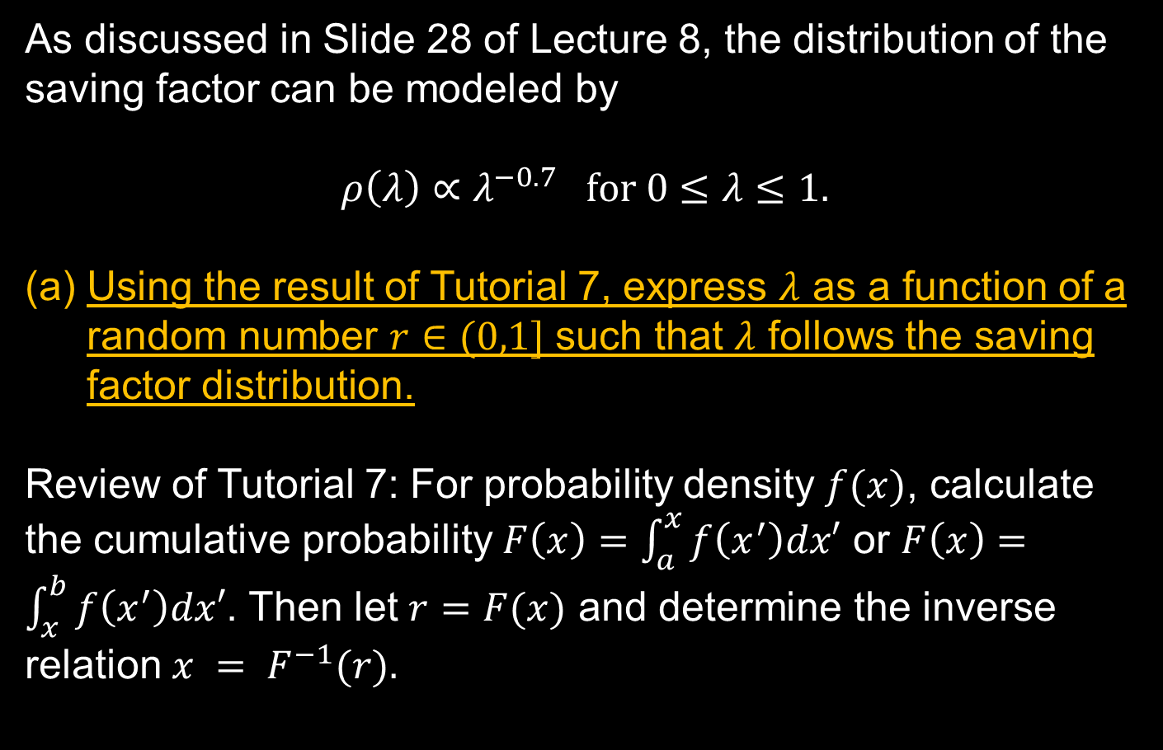
Generation of the Distribution of Saving Factors
As discussed in Slide 28 of Lecture 8, the distribution of the saving factor can be modeled by
$$ρ\left(λ\right)∝λ^{−0.7} for 0≤λ≤1.$$
Using the result of Tutorial 7, express $λ$ as a function of a random number $r∈(0,1]$ such that $λ$ follows the saving factor distribution.
Review of Tutorial 7: For probability density $f(x)$, calculate the cumulative probability $F\left(x\right)=\int_{a}^{x}{f\left(x^{′}\right)dx′}$ or $F\left(x\right)=\int_{x}^{b}{f\left(x^{′}\right)dx′}$. Then let $r=F(x)$ and determine the inverse relation $x = F^{−1}(r).$

Slide 3

Pairing the Agents for the Transactions
At each iteration, the $N$ agents in the market are grouped into pairs and exchange their wealth through transactions. There are several possible ways to perform the pairing:
Fixed pairing:
The pairing is fixed and pre-determined. For example, agent 1 pairs up with agent 2, agent 3 with agent 4 …
However, this is not realistic because the wealth will not diffuse around the market.

Slide 4

Random Pairing
(2) Random pairing:
In each iteration, randomly select two agents to conduct the wealth exchange. The selection is repeated $N/2$ times in an iteration. The $2\left(\frac{N}{2}\right)=N$ selections made in each iteration are conducted with replacement.
However, some agents may be selected to pair up with himself/herself.
Furthermore, some agents will not be selected in an iteration, whereas other agents can be selected more than once in an iteration.

Slide 5
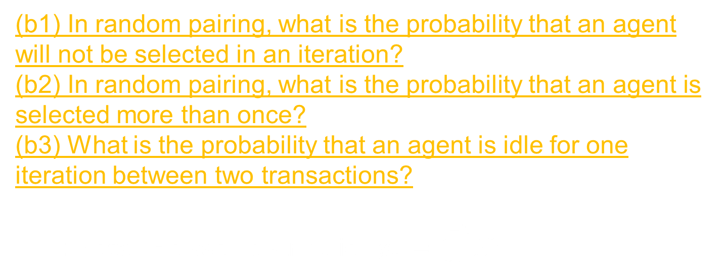
Random Pairing
(b1) In random pairing, what is the probability that an agent will not be selected in an iteration?
(b2) In random pairing, what is the probability that an agent is selected more than once?
(b3) What is the probability that an agent is idle for one iteration between two transactions?
Hint: Recall Poisson distribution $p_{n}=\frac{e^{−λ}}{n!}λ^{n}$.

Slide 6

Shuffled Pairing
(3) Shuffled pairing:
In each iteration, randomly select two agents. The selection is repeated $N/2$ times in an iteration. The $2\left(N/2\right)=N$ selections made in each iteration are conducted without replacement.
This can be programming efficiently in the following way:
(i) Prepare a stack/list/array of the $N$ agents.
(ii) Randomly choose an agent and cancel her address in the stack. The length of the list is reduced by 1.
The most convenient way to cancel the address is to move the last agent to the address to be canceled.
 |  |  | 4 | 5 | 6 |  |  | 9 | 10
 |  |  | 4 | 10 | 6 |  |  | 9

Slide 7
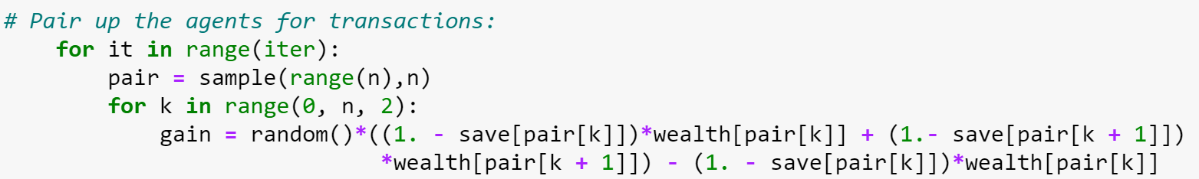
random.shuffle and random.sample
In Python, random shuffling can be done by the commands random.shuffle or random.sample:
random.shuffle replaces the list with a shuffled one
random.sample generates a new list
In random.sample(population, k), population is a list of length k or longer, k is the number of elements to be sampled.

Slide 8
random.shuffle and random.sample
In Python, random shuffling can be done by the commands random.shuffle or random.sample:
random.shuffle replaces the list with a shuffled one
random.sample generates a new list
In random.sample(population, k), population is a list of length k or longer, k is the number of elements to be sampled.
This is illustrated in the following slides.

Slide 9
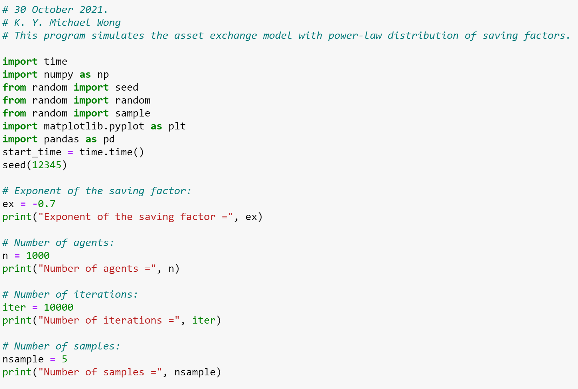
Front Matters

Slide 10
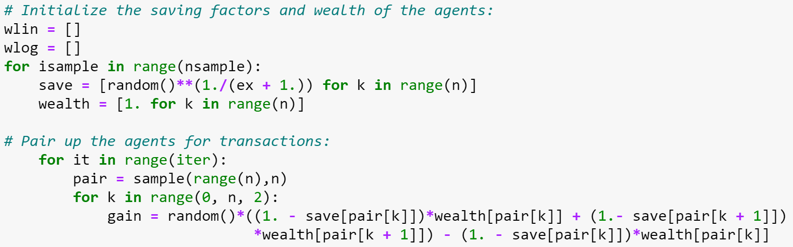
Use of ‘random’ commands
“random” is used to generate the saving factors.
“sample” is used to shuffle the population.
After shuffling, agents pair[k] and pair[k + 1] are paired for even k.
Note that when the saving factors and wealth are called, the original population order is not used. Instead, the paired order is used.

Slide 11
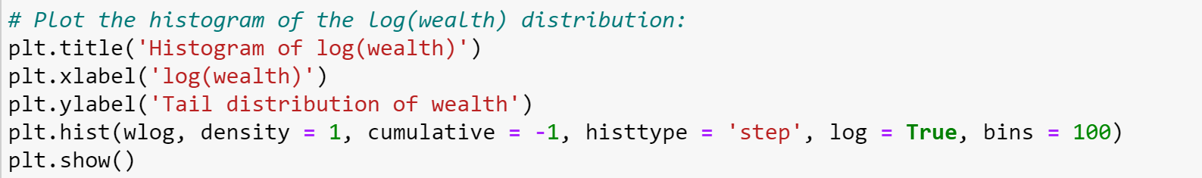
Log-log plot using plt.hist
wlog is a list containing log(wealth[k]) of all agents k.
density = 1: Normalized distribution
(output = counts/sum(counts)/bin width)
(density = 0 means output = counts)
cumulative = -1: cumulative distribution from the right end
(cumulative = True: cumulative from the left end)
histtype = ‘step’: for curves instead of bars
(Other choices: ‘bar’, ‘barstacked’, ‘stepfilled’
“log = True”: distribution in log scale along the vertical axis
The horizontal axis of plt.hist is linear. Log(wealth) should be computed before plotting.

Slide 12
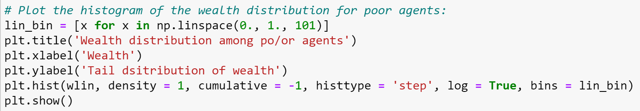
Log-linear plot using plt.hist
A log-linear plot is used to verify the exponential distribution of wealth for the poor agents.
wlin is a list containing wealth[k] for all agents k.
Since only the poor agents (with wealth less than 1) are considered, a sequence of bin_edges is provided to ‘bins’.

Slide 13
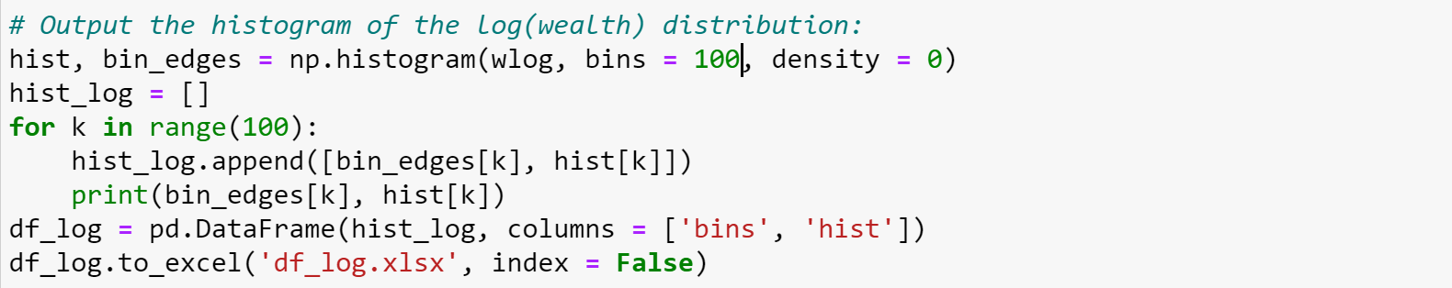
Histogram output using the np.histogram
It may be convenient to export the results to Excel to compute the slopes.
density = 0 because np.histogram does not produce cumulative plots. It is more convenient to output the exact counts.
hist and bin_edges are the two outputs of np.histogram.
The Pandas data frame is prepared by writing the bin_edges and the corresponding histogram values in the same row.

Slide 14
DataFrame Export to Excel
The Excel writer should be installed beforehand using “pip install openpyxl”.
pd.DataFrame is used to convert the list into a DataFrame.
<DataFrame>.to_excel writes the DataFrame to an Excel file.
“index = False” means that the index column will not appear in the Excel file.

